Slide 1

International Restructuring and Insolvency Regimes Through Covid-19 — A Continuing Evolution
Note: Approved cover photo images are available for download at dam.kirkland.com.
International Insolvency Institute’s 22nd Annual Conference
Impacts of Global Events on the International Insolvency Practice
September 7, 2022, Toronto, Ontario, Canada
9:30 am – 10:30 am
Presenter: James H.M. Sprayregen, P.C.
KIRKLAND & ELLIS LLP
300 North LaSalle, Chicago, IL 60654
T +1 312 862 2481 M +1 312 972 0542
F +1 312 862 2200
601 Lexington Avenue, New York, NY 10022
T +1 212 446 4800
F +1 212 446 4900
james.sprayregen@kirkland.com

Slide 2
Agenda
1 | The Big Picture
2 | Temporary Insolvency Reforms
3 | Restrictions on Enforcement
4 | Fiscal Measures
5 | Permanent Reforms

Slide 3

The Big Picture
Note: Approved cover photo images are available for download at dam.kirkland.com.

Slide 4
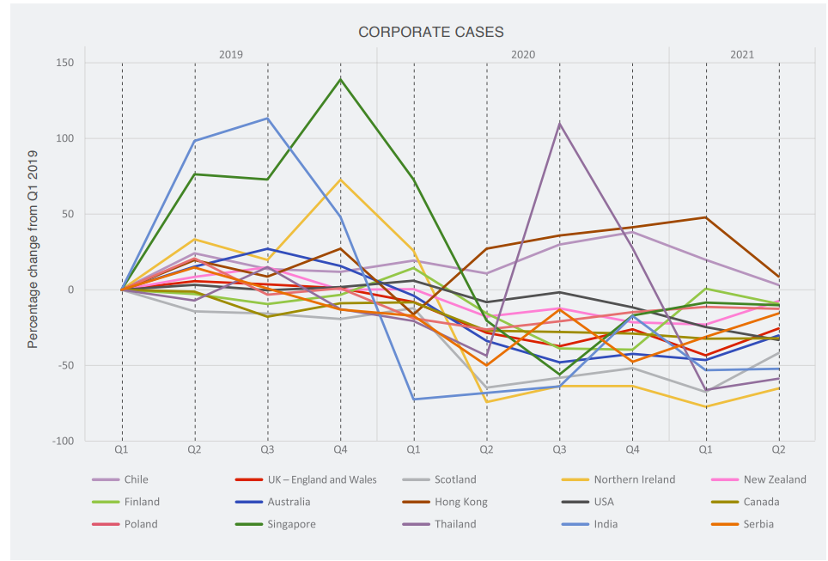
A (counter-intuitive) decline in corporate insolvencies
Taken from ‘From Hibernation to Revitalization: Analysis of Insolvency COVID-19 Response Measures and their Wind-Down’ by IAIR, Insol International and World Bank Group, May 2022 (“May 22 Report”)
Notes:
Of course, the Covid-19 health crisis quickly developed into an economic crisis – pandemic and accompanying lockdowns plunged the global economy into severe recession. Given so many companies saw revenue zero’d almost overnight, natural to expect flurry of insolvencies.
But – as you probably know – insolvency rates actually decreased through the pandemic, in nearly all jurisdictions.
Insolvency rates still remain below pre-pandemic levels in most jurisdictions; insolvency fillings globally currently 80% of pre-pandemic levels.
This is mainly due to unprecedented levels of government support and emergency measures to flatten the insolvency curve.
The anticipated wave of business insolvencies doesn’t yet appear to have arisen, but it’s too early to say if the risk has abated. The World Bank says evidence suggests that a rise in insolvency filings has been postponed but not avoided.

Slide 5
Unprecedented situation: wide-reaching support measures
Temporary insolvency reforms
    Relaxation of mandatory filing obligations
    Relaxation of directors’ duties
Restrictions on debt enforcement
    Stay / limitations on creditor actions
Fiscal measures
    Protection for rescue financing
    Government-backed funding / support
    Furlough schemes
Regulatory measures
    Tax reductions and deferrals
    Rates reductions
    Suspension of audits / account filing deadlines
Functioning of insolvency proceedings
    Virtual court hearings and creditors’ meetings
    Extension of procedural deadlines
Debt repayment
    Extension of repayment date
    Suspension of interest
    Prohibition on acceleration
Facilitating recovery
    Preparing for the aftermath
    Rules simplifying insolvency proceedings
Long term insolvency reforms
    New restructuring procedures
    Digitalization
Notes:
Covid was a dynamic and unprecedented situation: governments had to respond rapidly: there was no existing playbook
Universal challenge: how to support viable businesses but not prop up zombie companies. We’ll consider that further when we look at phasing out of temporary measures.
Numerous measures taken to provide breathing space. Broad categorisation here to illustrate different kinds of support measures.
Unprecedented levels of fiscal support. OECD estimates global fiscal support at $13.8 trillion as of May 2021 – an unprecedented figure.

Slide 6
Common themes and divergences
1
High income v low income nations
4
Easing burden on insolvency infrastructure
2
Expiration date & ease of extensions
3
Assessing debtor viability
Notes:
The World Bank / INSOL International study identified various themes around the emergency support measures
There was a notable divergence in measures introduced in high income countries vs low income countries. Broadly, high income countries tend to have more developed insolvency systems and were able to temporarily amend these fairly easily - whereas countries with less sophisticated systems could not respond as fluidly. In African jurisdictions, virtually no temporary insolvency-related measures were adopted – the focus was instead on fiscal support measures.
Most temporary measures had quite short initial periods which were often extended in response to Covid rates and successive lockdowns. Most have now finished or are tapering off. How to withdraw measures is a key consideration: worldwide recovery is uneven and uncertain. Governments aiming for cautious tapering of measures rather than a cliff edge.
On viability, the goal is of course to prevent insolvencies of companies that are distressed but still fundamentally viable. Governments have had to come up with mechanisms to triage the viable from non-viable businesses, to ensure support is properly targeted.
There was a risk that insolvency systems would have become overwhelmed/courts would have faced enormous backlog. The temporary measures were not only necessary for debtors, but also for institutions like the courts and other institutions carrying out insolvency and debt enforcement activities.

Slide 7
Prevalence of measures
Fiscal
    e.g., extension of repayment terms
    suspension of interest accrual
Debt Repayment Measures
  Most prevalent in all regions
  Most common in Middle East and Northern Africa (adopted in 87.5% of countries¹)
Courts
    to prevent court system being overwhelmed
Suspension of judicial proceedings
  Measures suspending judicial proceedings were adopted in ¾ of high- and middle-income countries
  34% of jurisdictions suspended ability to repossess property
Initiation of insolvency
    e.g., increasing monetary threshold to initiate insolvency proceedings
    increased time for debtors to respond to petitions
Suspension of creditor initiation of insolvency
  Common in high-income countries / non-existent in low-income countries
Directors’ duties
    e.g., suspension of duty to file (3/4 of cases)
    suspension of personal liability for wrongful trading
Relaxation of directors’ duties
  Few high-income countries / less common in low-income countries
1. of those included in the May 2022 report sample
Notes:
This slide illustrates how widespread different categories of support measures were.
For example, debt repayment measures were common everywhere but most common in countries with less developed insolvency systems: where insolvency systems were not expected to provide effective solutions, countries leaned most heavily on broad debt repayment measures
Only 5% of countries in May Report sample introduced some form of relaxation of directors’ duties.

Slide 8
Duration of measures
According to May 2022 Report
Notes:
You can see that debt repayment measures (e.g., extension of the repayment terms of loans or suspension of periodic debt service obligations) were of the longest median duration (500 days). Shortest median duration was recorded for measures suspending judicial proceedings (274 days)
All for a much longer time than anyone would have predicted at the start of the pandemic. If you assume most started in March 2020, that puts the average end date at May/June 2021.
The pandemic sparked digital changes and innovation in court processes (e.g., virtual hearings and meetings) which are now expected to become permanent features

Slide 9
Approaches by region¹
Region | Raising min. debt threshold for commencement of insolvency proceedings | Suspension of directors’ duties to file | Relaxation of wrongful trading | Extension of loan repayment terms | Suspension of interest accrual | Ban of property repossession | Liquidity support measures | New insolvency procedures
Asia Pacific | Australia, India, Malaysia, Singapore No new requirements introduced | New Zealand only - but many jurisdictions have no express filing duty | Australia, India, New Zealand, Singapore | Majority of regions | Cambodia, China, Kazakhstan, Malaysia, Philippines, Singapore, Tajikistan, Vietnam | Malaysia, Singapore |  | Australia, China, Singapore
Europe, Middle East and Africa | Hungary, Ireland, Malta, Romania, (later UK) Uncommon in Middle East and Africa No new requirements introduced | More than half of European jurisdictions including Austria, Belgium, Portugal, Spain, Germany | UK, Germany, Malta, UAE Nowhere in Africa | Cyprus, Hungary (legislation); Bulgaria, France, Greece & Ireland (govt. recommend-ations); Middle East and Africa | Majority of European jurisdictions | ¼ to ½ of Europe, some in Middle East and Africa | Most European and Middle East Some African | 19 European countries and UAE
US, Canada, Mexico | X | X | X | US, Canada | Not on commercial loans (but many lenders did consensually in US) | US and Canada: residential only but many consensual agreements commercially | US: $2 trillion stimulus package, Canada | X (only temporary or procedural changes introduced)
Latin America | X | Columbia | X | Columbia | Argentina, Chile | Columbia, Chile, Brazil | Common: Argentina, Brazil, Peru | Brazil
1. High level summary, based on broad findings of the May 2022 Report
Notes:
Clearly can’t speak to all the jurisdictions in this table but this is to present broad themes that we can pick out.
Majority of countries in Asia Pacific Region introduced measures extending the repayment terms of loans during Covid 19. However, only 3 countries in region reformed their insolvency regimes.
All European jurisdictions went into a government ordered lockdown at some point which particularly affected travel, hospitality and leisure sectors – but we saw a swift government response across the region including compensation for businesses who lost income. Some jurisdictions adopted a range of measures (e.g., Austria, Germany, Malta and Slovenia) whilst some adopted hardly any directly related to insolvency (e.g., Albania, Greece and Serbia).
In lots of European jurisdictions we saw formal introduction of barriers to creditors initiating insolvency proceedings. However, in other jurisdictions the same result was achieved simply as a practical consequence of court closures (e.g., Bulgaria and Greece did not formally adopt such measures).
In African jurisdictions, virtually no temporary insolvency-related measures have been adopted, and the focus has instead been on broad policy, fiscal, and administrative support measures, such as government assistance for MSMEs and debt repayment measures. This is not surprising because the local culture and infrastructure are less focused on corporate insolvency and provide less detailed tools. UAE did make permanent amendments to its insolvency regime.
In less mature insolvency markets of Latin America, pandemic did not itself result in significant permanent structural changes to insolvency market. They were already in the process of adopting insolvency related reforms pre-pandemic. It remains to be seen whether the pandemic will accelerate or otherwise shift trend.
Mexico is an example of a country which provided little financial assistance for individuals and businesses: this has resulted in serious economic and social repercussions. Insolvency infrastructure couldn’t deal with demand.
Most Latin American central banks made efforts to provide liquidity but, on the whole, companies had a need for US dollar liquidity (a currency their central banks cannot issue)
Less information available for Latin America as less countries responded to the May 2022 Report survey.

Slide 10
Temporary Insolvency Reforms
Note: Approved cover photo images are available for download at dam.kirkland.com.
Notes:
I’ll now take a closer look at specific temporary measures in different jurisdictions and draw out some themes

Slide 11





Relaxation of directors’ risk of personal liability e.g., for wrongful trading, reckless trading, insolvent trading
United Kingdom
Against backdrop of potential personal liability for wrongful trading, new rules meant directors could not be liable for any worsening of the company’s financial position, 1 March 2020 - 30 September 2020 and 26 November 2020 - 30 June 2021
New Zealand
Provided a company was solvent on 31 December 2019 and the director reasonably believed it would recover, during the safe harbor period (3 April 2020 – 30 September 2020), the actions of a director would not be reckless trading if the director believed that the company’s liquidity problems arose from the effects of the pandemic
Singapore
A director who incurred debt in the relevant period (April 2020 – 31 December 2020) had a defence against personal liability for incurring debts without the reasonable prospect of meeting them in full
Australia
Directors were not liable for incurring debts while insolvent (insolvent trading) in relation to any debt incurred by the company in the period 25 March 2020 – 31 December 2020
Germany
Suspension of directors’ obligations regarding trading in the zone of insolvency, between 28 March 2020 – 30 April 2021
Notes:
The crisis clearly made it very difficult for directors – there were so many uncertainties that directors couldn’t predict whether a company would survive in the long-term. Governments were trying to encourage directors to take reasonable actions to trade through the pandemic rather than being forced into insolvency because of concerns about personal liability.
So we commonly saw a temporary suspension or relaxation of the wrongful trading (or equivalent) rules in jurisdictions across the world.
Directors in all jurisdictions still needed to be alert to the risk of fraudulent trading, duty to act in best interests of the co., etc.

Slide 12
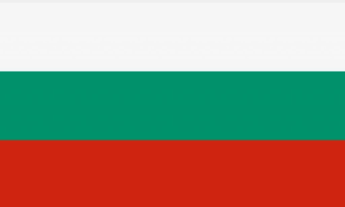





Relaxation of mandatory filing obligations
Pre-Covid: Duty to File
During Covid: Relaxation
Germany
Within 21 days of an insolvency event (cash-flow or balance sheet insolvency)
Duty to file suspended until 31 March 2021
BUT only where illiquidity temporary and caused by the pandemic
Bulgaria
Within 30 days of insolvency or over-indebtedness
Duty to file suspended until one month after end of state of emergency (ended 31 March 2022)
Austria
Within 60 days of insolvency or over-indebtedness
Duty to file within 120 days where insolvency is partly caused by natural disaster (including Covid)
No requirement to file for over-indebtedness occurring between 1 March and 31 January 2021
France
Within 45 days of cash-flow insolvency
Duty to file was suspended from 12 March to 24 August 2020
Spain
Within 2 months of the date on which directors became, or should have become, aware of the insolvency
Duty to file was suspended during state of alarm and until 31 December 2020
Luxembourg
Within one month of cash-flow insolvency and loss of creditworthiness
Duty to file was suspended during state of emergency, until 30 June 2021
Switzerland
When the company becomes over-indebted (i.e. balance sheet insolvent)
Released from obligation to file (until October 2020) providing the company was not over-indebted at the end of 2019 and there was a prospect of remedy by end of 2020
Notes:
Several continental European jurisdictions impose some form of mandatory insolvency filing obligation on directors.
Where there is a duty, we saw a near-universal relaxation of it – allowing directors more leeway to take effective action through the pandemic. Jurisdictions’ approaches differed as to length of suspension and whether or not the relaxation should apply to companies already in difficulty pre-crisis.
Outside Europe, however, very few countries adopted such relaxations – just not necessary in most countries.
Further info:
Length:
Some jurisdictions only relaxed duty for a short time (e.g., Luxembourg only suspended during state of emergency, Bulgaria suspended until one month after end of state of emergency. Spanish approach was similar at first but subsequently until 31 December 2020.) Germany did a fixed length (with possibility to extend) independent of state of emergency.
Attempt to limit to viable companies only:
Germany: illiquidity must be temporary and caused by pandemic
Switzerland: company must not have been over-indebted at end of 2019 and there must be a prospect of remedy by the end of this year.
France, Spain, Bulgaria – applied to all companies.

Slide 13
Restrictions on Enforcement
Note: Approved cover photo images are available for download at dam.kirkland.com.

Slide 14
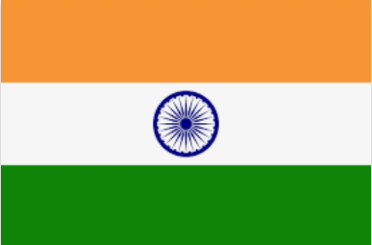


Stay / limitation on creditor actions
Suspension of creditors’ rights to initiate insolvency proceedings / landlords’ eviction rights
Australia
Monetary threshold for statutory demand increased from $2000 to $20,000 (until 31 December 2020)
Time limit for a company to respond to a statutory demand increased from 21 days to 6 months (until 31 December 2020)
Singapore
Monetary threshold for statutory demand increased from SGD 10,000 to SGD 100,000
Time limit for a company to respond to a statutory demand increased from 21 days to 6 months
United
Kingdom
Winding-up petitions (creditor-led requests for company to enter liquidation, akin to U.S. Chapter 7 proceedings) only possible where insolvency would have arisen irrespective of Covid-19 (27 April to 30 September 2021) (extension for commercial leases pending new arbitration regime)
Introduction of a standalone moratorium (permanent reform)
Suspension of evictions of commercial tenants until 25 March 2022
India
Minimum default amount for initiating corporate insolvency procedure increased 100x (from INR100,000 to INR10,000,000) (permanent measure contemplated pre-Covid)
Turkey
Temporary suspension of creditors’ enforcement rights from 22 March to 30 April 2020 (extended to 15 June 2020)
Suspension of evictions of commercial tenants
Belgium
Moratorium on enforcement by creditors from 24 April 2020 to 17 June 2020
Reintroduced from 24 December 2020 to 31 January 2021 (for closed businesses)
Cf. New Zealand
Business Debt Hibernation regime – one month moratorium for viable debtors who elected to enter “hibernation”
  binding on all creditors if approved by >50% in value and number
Notes:
To protect companies from aggressive debt recovery action during the crisis, certain jurisdictions took steps to limit creditors’ enforcement rights.
Broadly fell into two camps: temporary suspension of their normal rights OR a restriction of their normal rights. The most common approach here was by dramatically increasing the monetary threshold for issuing a statutory demand. This didn’t make it impossible for a creditor to wind up an entity but it makes the insolvency presumption harder to satisfy.
Several countries (including Italy, Spain, Switzerland and Turkey) suspended creditors’ rights to initiate insolvency proceedings against all companies.
Contrast this approach to Russia which introduced a 6 month moratorium on new bankruptcy proceedings (but limited to a specific list of industries that are heavily affected by the pandemic, and systemically important companies).
The UK introduced a new standalone moratorium in an attempt to give breathing space so that a struggling company can propose and pursue a rescue plan (albeit with major exceptions – falls far short of Ch. 11 automatic stay)

Slide 15
Fiscal Measures
Note: Approved cover photo images are available for download at dam.kirkland.com.

Slide 16
Government support
1
Loans
5
Support for specific sectors e.g., tourism, aviation
2
Guarantees
4
Protection of employees
3
Tax Reductions and Deferrals
Notes:
Governments took a very diverse approach to fiscal support. Drawing out some common themes:
Government loan schemes
Government guarantees
Tax cuts / deferrals and holidays
Widespread employment protection measures – especially furlough schemes, short-time work schemes and wage subsidies, to prevent termination of otherwise-viable jobs during the pandemic
Also targeted support for specific sectors most-impacted - e.g., tourism and leisure - e.g., Swedish aviation guarantee scheme
Point here is that such measures were highly variable - no uniform system

Slide 17

Examples of Government and Central Bank support
Singapore
$4bn Stabilization and Support Package
Support for aviation, tourism, food services, land transport and arts & culture
Enhanced SME Working Capital Loan (up to $1 million)
Temporary bridging loan (one year, interest capped at 5%)
Austria
Government guarantees for working capital loans
Bridge Finance guarantees (max. €40 million per group for max. 5 year term)
Specific support for tourism and leisure and export companies
Hardship funds / tax-exempt grants
Belgium
€50 billion Government guarantee for new loans
Bank loan payment extension
Mobilization of private savings through proxy loans for SMEs (resulting in tax relief for lender)
Income tax payment extension
United
Kingdom
Various loan schemes including Bounce Back Loans and Business Support Loans
Future Fund convertible loans for innovative companies
Business rates relief / reduced rate of VAT for tourism and hospitality
Belgium
€48 billion loan scheme
Extension of credit guarantees to promote Swedish exports
Aviation guarantee scheme
Tax deferrals for companies; grants for reduction in turnover
Germany
KfW (German state-owned development bank) loans up to €100m per group
Instant loan programme for investment and working capital with limited credit risk assessment
Guarantees for systemic companies
Tax deferrals / reduced rate of VAT / increased tax allowances
Notes:
A few specific examples of fiscal support measures here.
EU’s state aid regime has traditionally restricted the form and quantity of financial assistance provided by Member States.
The European Commission adopted a Temporary Framework, in March 2020, to provide more flexible State Aid rules to support the economy through the pandemic. The Framework ended up enabling governments to provide subordinated loans and to recapitalize distressed debtors in return for equity stakes.

Slide 18


Protection for rescue financing
Colombia
Implemented a similar rescue financing regime to US and Singapore
Italy & Spain
Suspended usual rules on subordination of loans given by connected parties
Germany
Repayment of “true” new money advanced (and related collateral granted) before 30 September 2020 is protected from claw-back in subsequent insolvency proceedings (provided repaid by 30 September 2023)
Shareholder loans will not be equitably subordinated (where granted before 30 September 2020 and repaid by 30 September 2023)
Mitigation of risk for creditors being held liable to other creditors where new money contributes to delay or “deepening” insolvency
cf. United Kingdom
No formal provision for post-petition financing
Notes:
So many companies faced a sudden liquidity crisis – and so certain jurisdictions introduced measures to facilitate rescue financing. These were in addition to government-backed bailout schemes – outside our scope today.
For example, Colombia introduced a form of DIP financing similar to that in US and Singapore – giving new money super priority.
Italy, Spain and Germany suspended rules subordinating loans from connected parties – aimed at encouraging shareholders and related parties to invest through the crisis.
Germany went further in protecting new money from potential clawback provisions.
In contrast, the UK has no formal provision for post-petition financing, despite extensive reforms enacted in June 2020 - many see this as a missed opportunity

Slide 19
Permanent Reforms
Note: Approved cover photo images are available for download at dam.kirkland.com.
Notes:
Some countries complemented temporary measures with deeper, permanent reforms.
Let’s pick up a few examples, looking at how they facilitate crisis recovery.

Slide 20

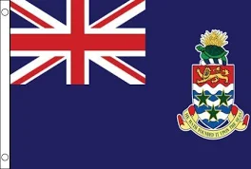
New quasi-judicial or hybrid restructuring procedures
Netherlands
WHOA aka “Dutch scheme”
a new flexible cross-class cram-down procedure modelled on U.S. Chapter 11 and the UK scheme of arrangement
United Kingdom
Restructuring plan:
  a new flexible cross-class cram-down procedure
New stand-alone moratorium
Wider ‘ipso facto’ provisions to prevent suppliers of goods and services from hindering corporate rescue
New arbitration regime to deal with Covid-related commercial rent arrears (albeit only 6-month window – but framework now in place in the event of future lockdowns)
Germany
StaRUG aka “German scheme”
  a new flexible cross-class cram-down procedure
Option for debtor to apply for court-appointed mediator (“restructuring facilitator”) to assist negotiations with creditors
Cayman Islands
New corporate restructuring process
Introduction of a dedicated restructuring officer (appointment triggering automatic global moratorium)
Notes:
In some jurisdictions, the pandemic presented an opportunity to fast-track major restructuring reforms.
Netherlands marked its reforms as an emergency bill (it had previously been debated in parliament for 7 years); UK accelerated the introduction of reforms which had been proposed back in 2018 but had stalled because so much parliamentary time was devoted to Brexit. Germany and Poland likewise – followed by other European jurisdictions, as part of implementing the European Restructuring Framework Directive.
Contrast Italy – delayed the introduction of its new Code of Corporate Crisis and Insolvency a few times given concerns about implementing significant reforms during a challenging period.
Two-pronged approach in many jurisdictions – on the one hand, trying to keep viable companies out of insolvency/restructuring procedures, but on the other hand to make restructuring procedures more flexible and available so that businesses could emerge from the pandemic stronger and more viable.

Slide 21
Simplified restructuring / liquidation procedures for MSMEs
Australia
New rescue process exclusively for SMEs (drawing on US Chapter 11) and quicker liquidation process
France
Temporary procedure (open until 2 June 2023) for small companies (less than 20 employees) which are insolvent as a result of the pandemic but had no difficulty before
Singapore
New Simplified Insolvency Program (SIP) for MSMEs – currently extended to July 2022; simplified debt-restructuring and winding up measures
India
Adopted a simplified “pre-pack” process
Notes:
The majority of insolvency systems, even in developed jurisdictions, are not prepared to handle a wave of MSME bankruptcies.
MSMEs are particularly fragile in the context of COVID-19.
Several jurisdictions introduced tailor-made measures for MSMEs, including new frameworks. Common features are simplified procedures with certain standardised elements; this facilitates negotiations and reduces costs.

Slide 22

Institutional capacity
Mexico
Introduction of digital platform enabling courts to carry out virtual court hearings, facilitating filing of claims and access to services
Germany
Planned increases to insolvency court staff and move towards predominantly written proceedings via digital means
+ accelerated digitalization across many jurisdictions
Notes:
A number of jurisdictions have recently been strengthening their courts’ capacity by hiring more judges and court staff and digitalizing many court and debt enforcement services.
This includes increasing use of electronic case management, online auctions, electronic voting, and automated court proceedings.
During the pandemic recovery stage, technology can play an important role - for MSMEs in particular, offering greater access to financial expertise by linking small business debtors with low-cost expertise and facilitating restructuring negotiations.

Slide 23
Concluding Thoughts
Note: Approved cover photo images are available for download at dam.kirkland.com.

Slide 24
Concluding thoughts
Temporary measures were broadly effective in preventing a tidal wave of insolvency filings
No co-ordinated approach
  Lack of uniformity adds to complexity
  But individual jurisdictions were able to respond swiftly, in accordance with varying impact of Covid-19 and national priorities / sensitivities
Challenge is how to taper off measures against ongoing macro-economic uncertainties
Substantial minority of temporary measures remain in place
Benefits of continuing enhancements to insolvency / restructuring regimes
Notes:
The absence of a huge wave of insolvencies indicates the temporary measures adopted were broadly effective. However, it’s too early to say if the risk has passed. New challenges affecting the recovery path are unfolding across the world – given the rates environment, inflation, the war in Ukraine, supply chain disruption etc.
The lack of a co-ordinated approach across jurisdictions added complexity (especially for international groups and their advisers!) – but is understandable given the unprecedented situation, the varying impact of Covid-19 across jurisdictions and the speed measures were introduced
Most measures were temporary and it is appropriate that they now roll off. Measures are expensive and interfere with proper market functioning.
High rates of zombie companies - that don’t make enough money to pay down debt-servicing costs – drain productivity from the economy and crowd out credit to healthier firms. So governments need to be careful that any prolongation of temporary measures doesn’t cause zombie firms to proliferate.
The focus is on ensuring withdrawal is gradual and doesn’t create a cliff edge. In particular, we are seeing carefully targeted ongoing support for industries that continue to be impacted.
There are major benefits to proper insolvency regimes – enhancements of those regimes is perhaps a silver lining of the Covid-19 pandemic.

